Slide 1
Diversity Inside Out - Module 1:
Benefits of a Diverse Workforce for Organisations and Individuals
"The European Commission support for the production of this publication does not constitute an endorsement of the contents which reflects the views only of the authors, and the Commission cannot be held responsible for any use which may be made of the information contained therein."
Notes:
See these notes on employment rights in NL (Conversation Club Facilitators’ Guide)

Slide 2
Welcome!
Find the settings option to test your microphone if you have one.
To participate via text chat during the session find the icon on your screen to the right left select 'Everyone’.
NB. If you lose audio in the session, please let me know!
During the session, please mute your microphone unless you wish to speak.
If you lose connection, you can re-join this meeting by following the original link we sent you in your email.
Thanks. Say hi in the chat box.
Grab a paper and pen to make notes.
We will send you some resources and further information after today’s session

Slide 3
Please drop in chat:
Your name? What is your current job role?

Slide 4
Inova Aspire
Inova Aspire provides high quality training and educational programmes to empower individuals and organisations.
Our commitment is to embrace diversity in the field of gender, disability, race, age and religion in order to support personal and professional development.
Themes for our training: wellbeing and happiness, mindful approaches, innovation in mindful ageing, equality approaches, youth development to address worklessness, women’s leadership development.

Slide 5
Diversity Inside Out Project
The concrete objectives of this project have been identified as follows:
Promote the business case for a diverse workforce.
Explore the barriers to diversity and inclusion in organisations, paying particular attention to post-Covid-19 impacts, especially on hard-hit groups of employees.
Encourage implementation of inclusive working practices.
Ascertain innovative practices to promote a diverse, welcoming and inclusive environment.
Investigate current practice such as microaggressions, communicating non-tolerance behaviour.
Create accepting climates where all individuals can thrive in the work environment.
Create a climate for honest crucial conversations sharing experiences to determine what works at local level with regards diversity and what still needs attention.

Slide 6
We will cover briefly:
Benefits of gender equality-the business case
Inclusion and diversity mindsets- what do we need to pay attention to in organisations e.g. language
Making change happen-cultural leadership
Discussions of pertinent issues case studies

Slide 7
Group Agreement
To be discussed and agreed with learners
Sharing information but respecting business privacy
Confidentiality
Openness and honesty
Listening with attention
Acceptance
Anything else?

Slide 8
We will cover briefly:
Benefits of gender equality and business case for diversity
Business argument for diversity-bottom line
Fairness
Individual rights

Slide 9
Why should we pursue gender equality?
Business Case
McKinsey and Company Report Women Matter 2015
Women in board and senior positions contribute to performance and profitability.2015
Diverse organisations more likely to outperform non-diverse organisations
Diversity improves strategic thinking, decision making and contributes to the bottom line, creativity, innovation, growth, profit.
Notes:
See McKinsey reports 2015/ 21.
NL?
See Women in the Workplace 2021
https://www.mckinsey.com/featured-insights/diversity-and-inclusion

Slide 10
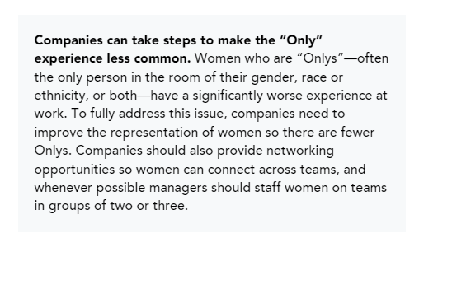
Why should we pursue gender equality? Business case
‘The potential benefit to the UK economy from full representation of BME individuals across the labour market, through improved participation and progression, is estimated to be £24 billion a year, which represents 1.3% of GDP .’
McGregor Smith Review (2017)
Notes:
These findings have been confirmed in more recent research. Do we have something similar relating to findings in the Netherlands?
See McKinsey reports 2015/ 21.
NL?

Slide 11
Why should we pursue gender equality? Business Case
Stakeholder demand:
Investors
Employees
Local community
Customers
Drive for transparency and metrics
Measurement and data driving change
Openness- interest, demand for change.
Recruitment and retention
Reputational effects + and -

Slide 12
Why should we pursue gender equality? Business Case
Example:
In USA Nasdaq named to 2021 Bloomberg Gender-Equality Index
The reference index measures gender equality across five pillars: female leadership and talent pipeline, equal pay and gender pay parity, inclusive culture, sexual harassment policies, and pro-women brands. Nasdaq was included in this year’s index for scoring at or above a global threshold established by Bloomberg to reflect a high level of disclosure and overall performance across the framework’s five pillars.
Competitive edge for recruitment and with other brands/ providers
https://www.nasdaq.com/articles/nasdaq-named-to-2021-bloomberg-gender-equality-index-2021-02-03
Notes:
Organisations having taken measured action to improve situation enhance position
Appeals to employees
Investors
Customers
More buying power
Recruit from a talent pool- want to work from them
Signals psychological safety
What do people want when they join an organisation: belonging/ connection/ meaningful work and-
Openness – it is safe to express thoughts, ideas, and concerns.
Equality – there is a perception of fairness, an equal chance for all employees to succeed.
Belonging – employees share a positive connection to each other and the organization.
https://www.mckinsey.com/featured-insights/gender-equality/taking-the-lead-for-inclusion

Slide 13
Harvard Business Review research (April 2021 150 multinational firms in Europe analysed)
What are mechanisms that deliver higher performance with gender equal organisations?
Women on boards/ senior positions?
Open to change and less open to risk
Change in strategic thinking and decisions
More investment in research and development
Weighing proposals for novelty with failure
Care less about tradition and challenge the status quo- drives change
Notes:
https://hbr.org/2021/04/research-adding-women-to-the-c-suite-changes-how-companies-think?utm_campaign=hbr&utm_medium=social&utm_source=linkedin
Note: one woman entering a board at senior level when only female on board has more impact than a new woman entering board where women are readily established

Slide 14
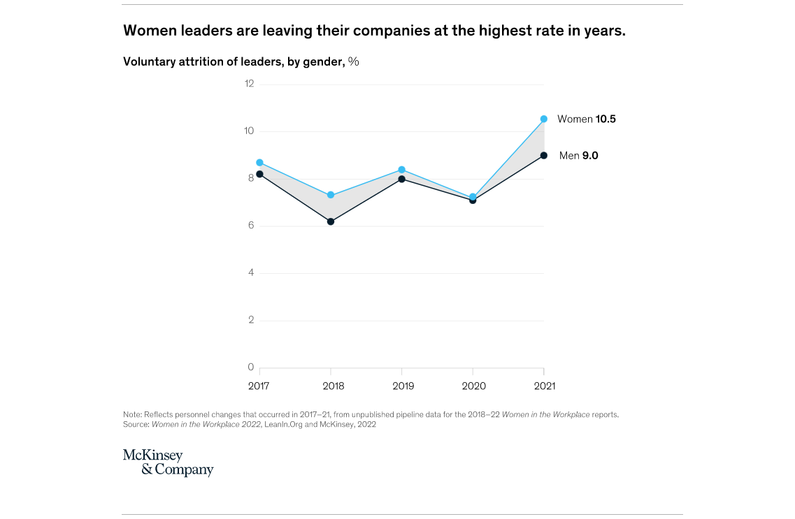
Women are leaving organisations (2022)
Notes:
https://www.mckinsey.com/featured-insights/diversity-and-inclusion/women-in-the-workplace

Slide 15
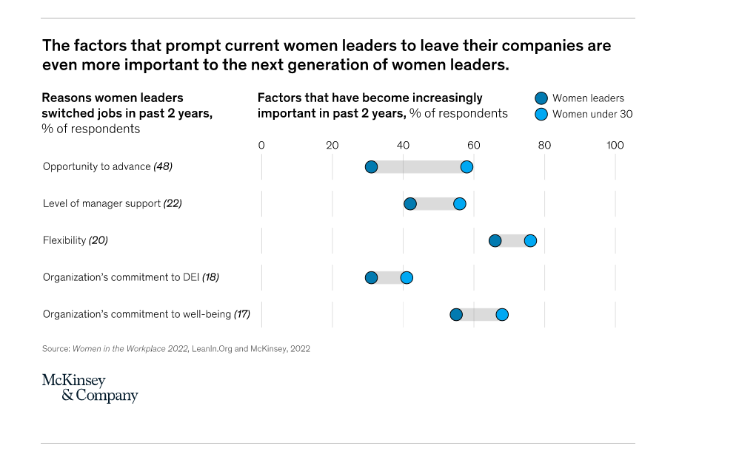
Why women are switching jobs
Notes:
https://www.mckinsey.com/featured-insights/diversity-and-inclusion/women-in-the-workplace (2022)

Slide 16
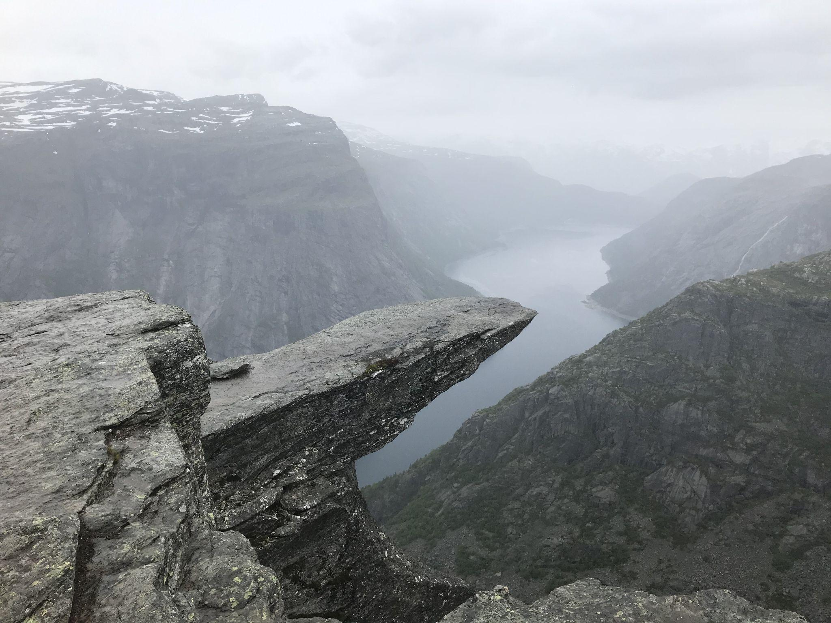
Also …the Glass Cliff Effect
Women and minoritised groups are more likely to be promoted to senior positions in times of crises when risks are greater and failure more likely!
Car les about tradition and challenge the status quo- drives change
Notes:
https://www.bbc.com/future/article/20220204-the-danger-of-the-glass-cliff-for-women-and-people-of-colour
Photo by Andrew H on Unsplash

Slide 17
Diversity breadth
Age
Race
Neurodiversity
LGBTQiA+
Physical disability
Mental health issues
Enduring health issues
Recent long Covid case has gone to appeal- likely to be classed as a disability in terms of Equality Act (2010)
https://www.peoplemanagement.co.uk/article/1790935/caretaker-successfully-claims-long-covid-disability-landmark-tribunal-case
Intersectionality
Notes:
Add more to slide re updated NL legal environment-check before delivery

Slide 18
Fairness
‘Employees not feeling treated fairly is central to job dissatisfaction and stress.’ (CIPD, 2021).
Recessions/ uncertainty- not much movement in labour market.
In times of boom, people become more mobile.
Dissatisfied staff may then leave.
When Covid hit, trust went up. Organisations seemed actively engaged in staff welfare which built trust and engagement.
Post Covid wellbeing was firmly on organisational agendas but slight return to normal.
Research is showing wellbeing and work life balance/ flexibility are crucial to employees.
Not a return to normal-a reset!

Slide 19
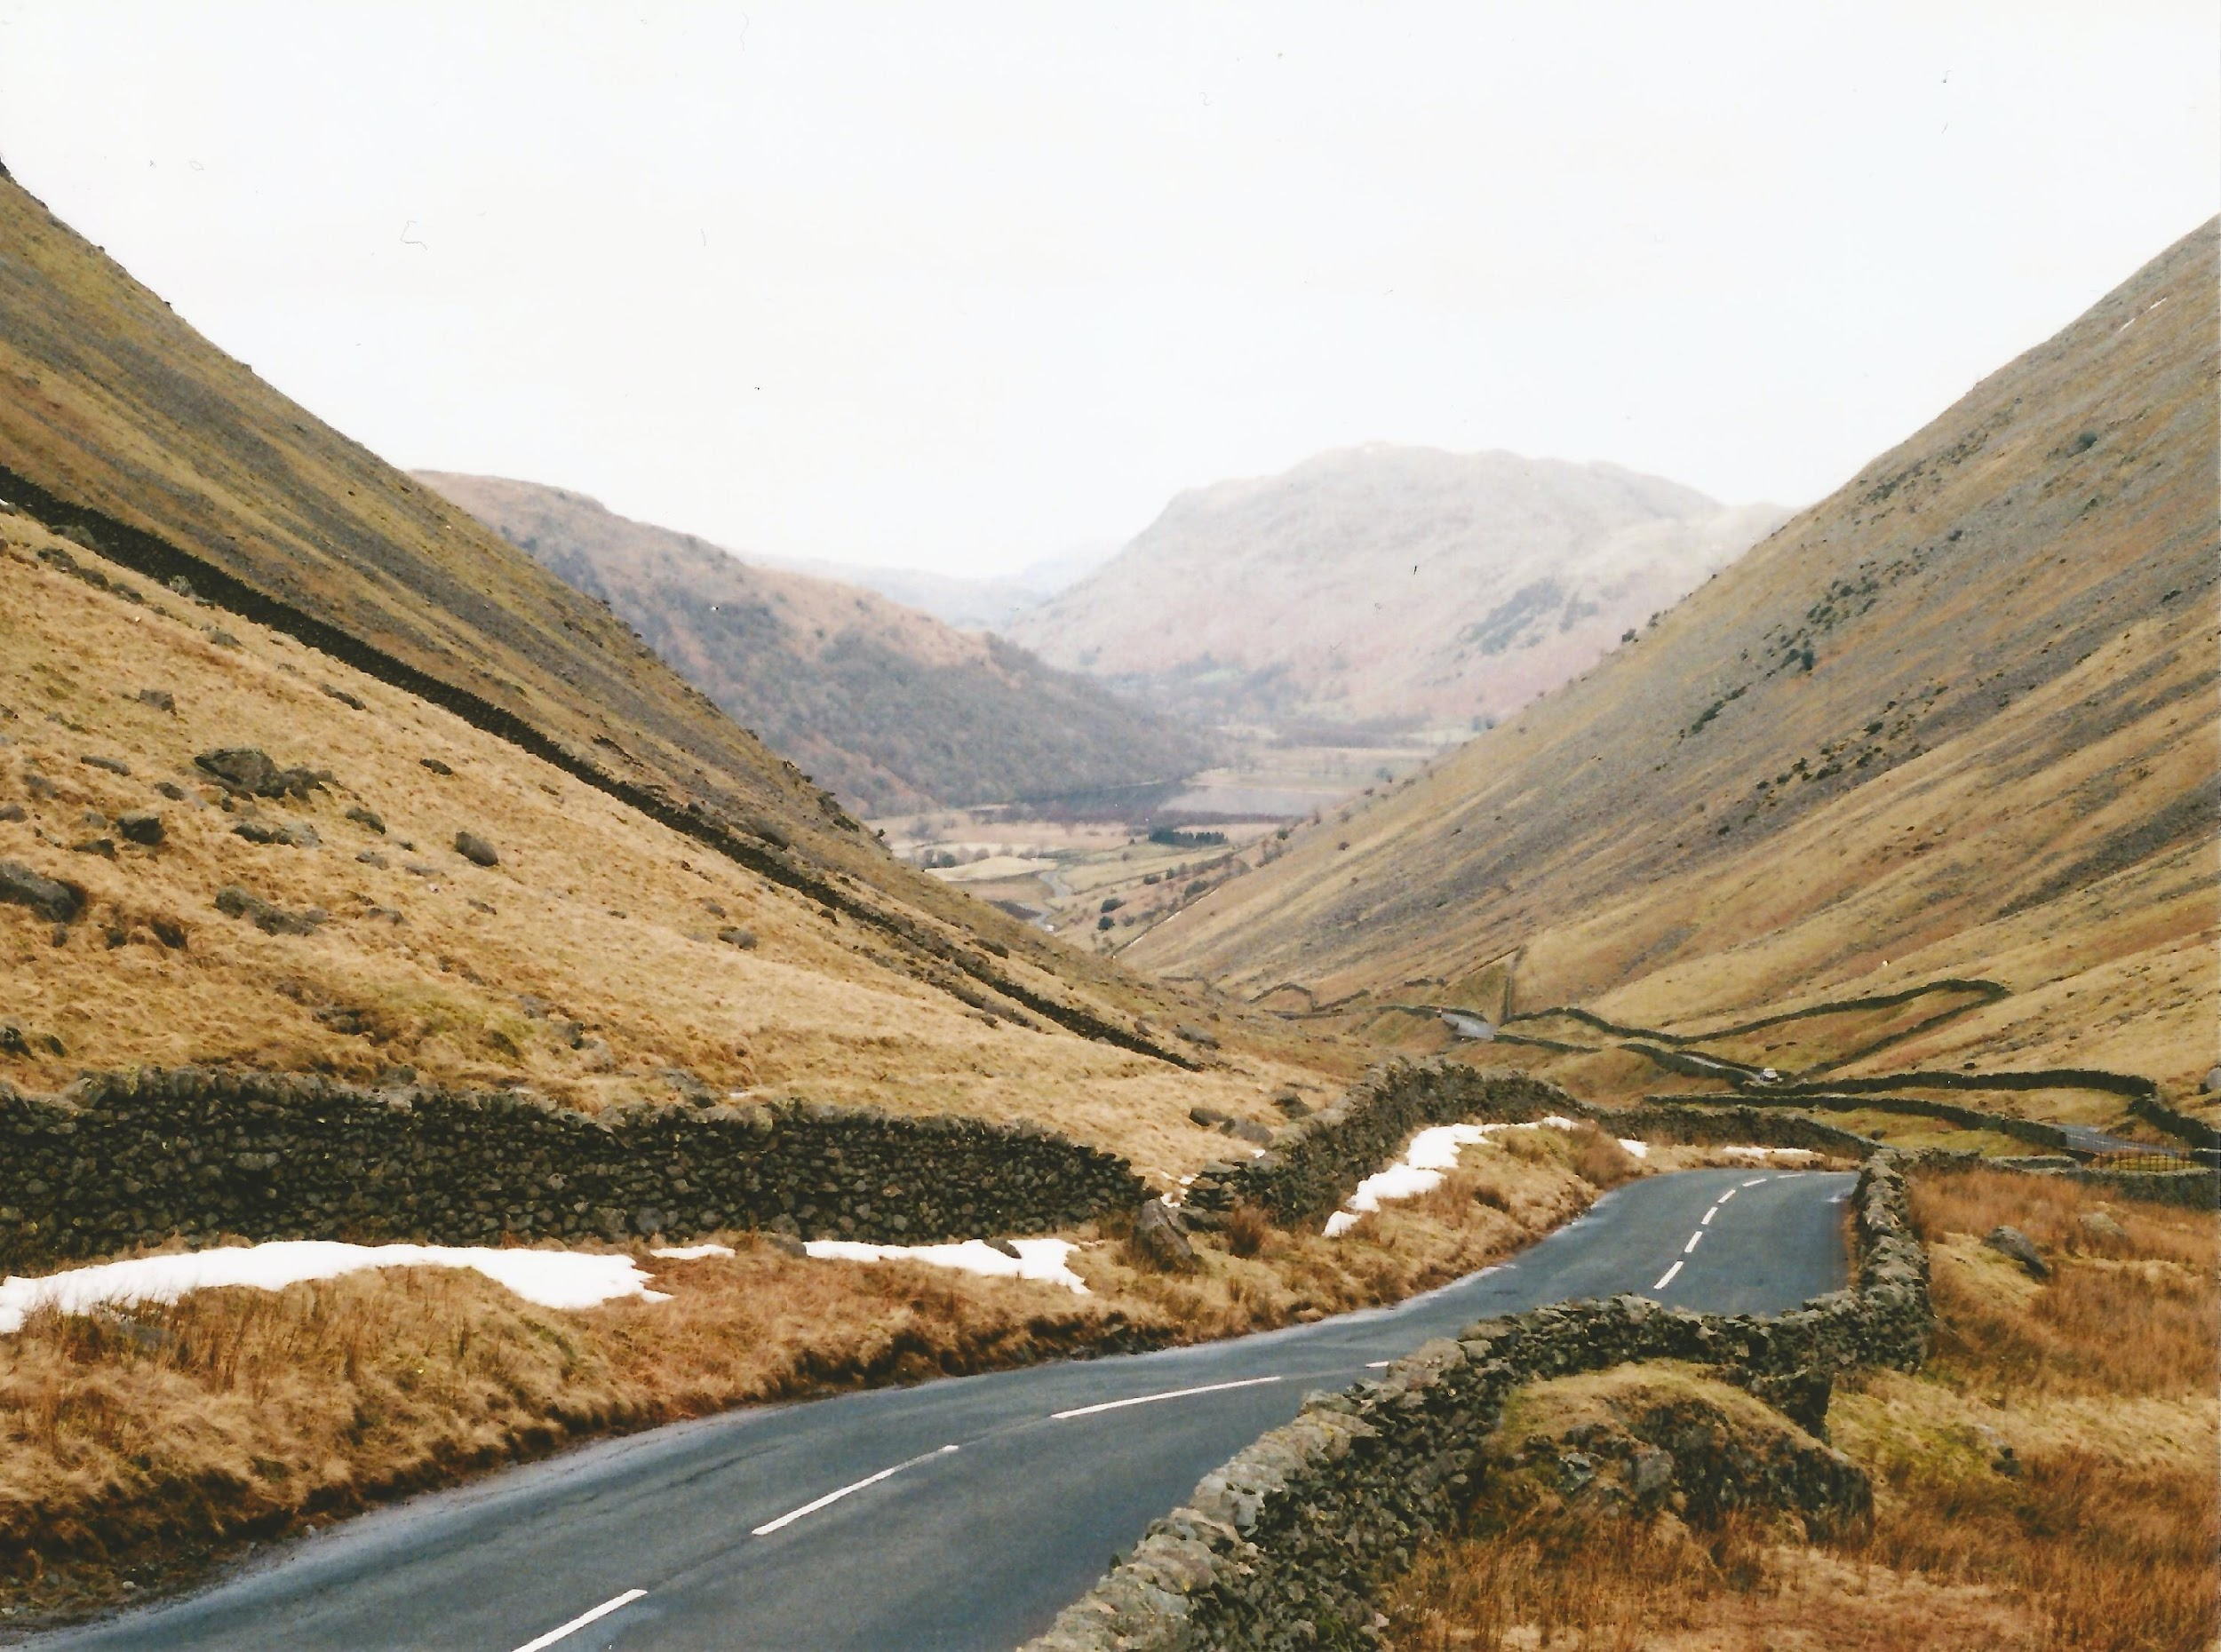
Gender equality is a shifting landscape
Definitions contested-BAME becoming outmoded-to better focus on understanding disparities and outcomes for specific ethnic groups.
Government abandoning unconscious bias training as poor evidence of efficacy.
Marginalised groups finding voices to drive changes they want to see.
Notes:
https://www.gov.uk/government/publications/the-report-of-the-commission-on-race-and-ethnic-disparities/summary-of-recommendations
https://www.gov.uk/government/publications/unconscious-bias-and-diversity-training-what-the-evidence-says
Me too, BLM, LGBTQi community, women going through menopause, people who have not had voices in organisations are finding voices to challenge status quo

Slide 20
Unconscious bias still relevant
Unconscious bias is when we make judgments or decisions on the basis of our prior experience, our own personal deep-seated thought patterns, assumptions or interpretations, and we are not aware that we are doing it. The irony is that prejudice and discrimination are inevitable by-products of the efficiency of human cognition.
Professor Uta Frith DBE FBA FMedSci FRS
Notes:
Source of definition of unconscious bias : - https://royalsociety.org/-/media/policy/Publications/2015/unconscious-bias-briefing-2015.pdf p2
The brain seeks to short-cut and categorise to enable quick decision-making.
These quick decisions helped us survive and defend ourselves.
The brain sifts vast amounts of information based on patterns.
Stereotyping, often seen in bias, is a cognitive unconscious short-cut, often based on faulty, non-logical thinking.
We are all affected by this.
Source: Professor Uta Frith DBE FBA FMedSci FRS

Slide 21
Current climate
The great resignation
Skills shortages
July 2022- skills shortages therefore, 80% of employers would recruit for potential rather than ability now
Inflation reducing value of money in our pockets
In work-poverty
Organisations need to widen the talent pool.
Photo by Christina @ wocintechchat.com on Unsplash
Notes:
https://www.gov.uk/government/publications/the-report-of-the-commission-on-race-and-ethnic-disparities/summary-of-recommendations
https://www.gov.uk/government/publications/unconscious-bias-and-diversity-training-what-the-evidence-says
Me too, BLM, LGBTQi community, women going through menopause, people who have not had voices in organisations are finding voices to challenge status quo

Slide 22
Organisations needs greater sensitivity when recruiting
Job seeker:
When a job advert says:
‘We welcome applications from marginalised groups’
I think of tokenism and that they just want a quote to look virtuous…it doesn’t encourage me to apply.
I want to be reassured they really understand structural inequalities and they have a plan of action and they are making progress.
I belong to a global majority!
Photo by Christina @ wocintechchat.com on Unsplash
Notes:
https://www.gov.uk/government/publications/the-report-of-the-commission-on-race-and-ethnic-disparities/summary-of-recommendations
https://www.gov.uk/government/publications/unconscious-bias-and-diversity-training-what-the-evidence-says
Me too, BLM, LGBTQi community, women going through menopause, people who have not had voices in organisations are finding voices to challenge status quo

Slide 23
Inclusion Philosophy
CIPD, (2019).
Notes:
Source: : https://www.cipd.co.uk/Images/building-inclusive-workplaces-report-sept-2019_tcm18-64154.pdf p25
In Chat? What are the challenges for this?
How terminology changes-awareness, acceptance.

Slide 25
For an inclusive workplace what do we need to pay attention to?
McKinsey’s definition of inclusiveness incorporates:
Openness – it is safe to express thoughts, ideas, and concerns.
Equality – there is a perception of fairness, an equal chance for all employees to succeed.
Belonging – employees share a positive connection to each other and the organization.
https://www.mckinsey.com/featured-insights/gender-equality/taking-the-lead-for-inclusion

Slide 26
But … mediated by culture
How we do thing around here:
Processes and systems
Habits and rituals
Artefacts e.g corporate strategy documents with no representation of women
Language
Psychological processes- othering
Biases
In/out groups
Up our game in terms of awareness!!
Notes:
Photo by Christina @ wocintechchat.com on Unsplash

Slide 27
Where do we start with cultural leadership?
The need for change can appear overwhelming.
Start to give people the language to talk about experiences.
Lived experience needs to start informing policy and strategy-adopt a phenomenological approach (what can be observed, people’s experiences inform policy).

Slide 28
What is phenomenology?
In simple terms, phenomenology can be defined as an approach to research that seeks to describe the essence of a phenomenon by exploring it from the perspective of those who have experienced it The goal of phenomenology is to describe the meaning of this experience—both in terms of what was experienced and how it was experienced.
(https://link.springer.com/article/10.1007/s40037-019-0509-2)
Notes:
Phenomenology:
https://link.springer.com/article/10.1007/s40037-019-0509-2

Slide 29
Diversity cards are based on lived experience
This project built diversity cards, stories of individual experiences in organisations.
If we understand the whole person, we can appreciate individual needs.
This gives an insight into diversity from an individual perspective which could inform organisational policy.
Notes:
Phenomenology:
https://link.springer.com/article/10.1007/s40037-019-0509-2

Slide 30
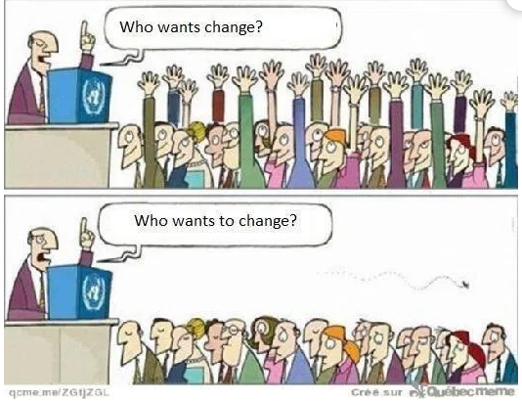
Cultural leadership
Notes:
Cartoon source:
https://participatorymedicine.org/epatients/2015/10/how-can-we-achieve-shared-work-connection-and-communication.html

Slide 31
Cultural leadership
Truism - lead from the top showing exemplary attitudes and behaviours, but needs to incorporate operational, developmental and strategic plans.
Strategic alignment - throughout all layers in organisation, behaviour, policy, strategy.
However: Trust often breaks down in organisations because of mixed messages and contradictory messaging .
Notes:
https://www.abstractuk.co.uk/leading-by-example

Slide 32
We will cover briefly:
Inclusion and diversity mindsets- what do we need to pay attention to in organisations e.g. language

Slide 33
Taking example of language
Our ethos is communicated in documents, emails, letters, invitations, telephone calls, texts, appraisals.
Language used can be rooted in stereotypical conditioning.
Gender bias can turn up in feedback and performance appraisals.

Slide 34
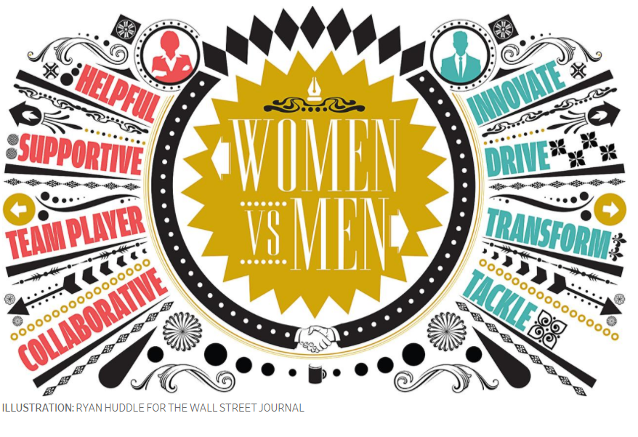
Gender and Culture bias in language of performance reviews
Notes:
Illustration copyright of Ryan Huddle for the Wall Street journal

Slide 35
Discussion- think about how language is used in your organisation
What examples do you have of gender or culture bias and exclusion in language?

Slide 36
Stanford University’s Clayman Institute for Gender Research findings:
Bias creates disadvantage.
‘Heidi seems to shrink when she’s around others, and especially around clients, she needs to be more self-confident.’ But a similar problem – confidence in working with clients – was given a positive spin when a man was struggling with it: ‘Jim needs to develop his natural ability to work with people.’
In another pair of reviews, the reviewer highlighted the woman’s ‘analysis paralysis,’ while the same behaviour in a male colleague was seen as careful thoughtfulness: ‘Simone seems paralyzed and confused when facing tight deadlines to make decisions,’ while ‘Cameron seems hesitant in making decisions, yet he is able to work out multiple alternative solutions and determined the most suitable one.’
The same behaviours are depicted in a biased manner.

Slide 37
Stanford University’s Clayman Institute for Gender Research findings:
Women’s evaluations contain nearly twice as much language about their communal or nurturing style (e.g., “helpful” or “dedicated.”)
Managers are nearly seven times more likely to tell their male employees that their communication style is too soft. Women, on the other hand, receive 2.5 times as much feedback related to their aggressive communication style.
Men are more than three times more likely to hear feedback related to a general business outcome.
Women’s evaluations contain 2.39 times the number of references to team accomplishments, as opposed to individual ones.
Men hear nearly twice as many references to their technical expertise and their vision.
Splitting-psychological effect. Women perceived as 'holding’ split off parts. Males find it harder to integrate and vice versa.
Notes:
Splitting-psychological effect. Women perceived as 'holding’ split off parts males find it harder to integrate and vice versa.
We need to pay very close attention to how we evaluate behaviours.

Slide 38
We will cover briefly:
Discussions of pertinent issues case studies

Slide 39
Task-cognitive dissonance
‘We are an inclusive organisation.’
What messages does your organisation give about inclusion/ exclusion?
What messages do organisations send out to individuals unwittingly?
What needs to change?

Slide 40
What works in countering bias?
One-off training does not necessarily lead to behaviour change
Ask for people to volunteer to do training and take part in working groups, don’t coerce people
Assume diversity and inclusion is a journey with no end point- constant work
Make sessions exploratory, rather than punitive. Use multiple voices to help people have a deeper, more nuanced understanding of different experiences as told through lived experience.
Use the concept ‘from whose gaze?’ are you viewing policy- adopt multiple perspectives for robustness.
Allyship- to be discussed in later modules.
Notes:
We may not have the language to discuss issues or be nervous of the most recent terminology in use. We can be afraid of offending people or not understanding or being clumsy with words and ideas.
Some actions punitive e.g when you take steps forward if you have privilege, but by pointing out privilege we still stigmatise those who don’t have it.
Language an issue
Organisations may talk about representation and be well meaning
However people may hear that as tokenism and be sceptical about the intent
Many things have been tried in the past and approaches may not have worked or have become discredited e.g quotas for women or BAME leaders
Politicise arena when we talk of rights
From whose gaze are we looking, implementing change?

Slide 41
Action Planning Data for decisions and measuring progress-do you have baseline data?
Notes:
Graphic pixaby

Slide 42
Mentimeter
What challenges do you see for you/ your organisation?
What challenges is your organisation facing now in terms of inclusion?
How has Covid added to the challenges?
Notes:
We may not have the language to discuss issues or be nervous of the most recent terminology in use. We can be afraid of offending people or not understanding or being clumsy with words and ideas.
Language an issue
Organisations may talk about representation and be well meaning
However people may hear that as tokenism and be sceptical about the intent
Many things have been tried in the past and approaches may not have worked or have become discredited e.g quotas for women or BAME leaders
Politicise arena when we talk of rights
From whose gaze are we looking, implementing change?

Slide 43
Evaluation form
Please complete this short evaluation form found in chat
Your feedback is so valuable to us!
Notes:
Add link in chat

Slide 44
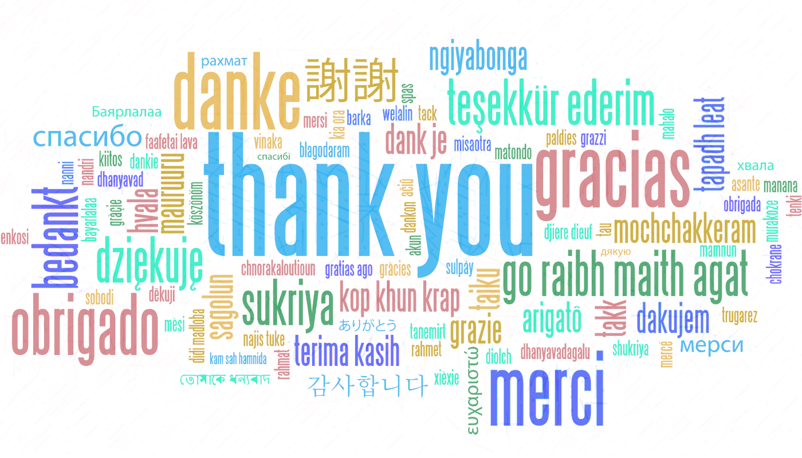
Any Questions? It’s been great to work with you all!

Slide 45
References and sources
https://www.mckinsey.com/business-functions/organization/our-insights/gender-diversity-a-corporate-performance-driver
https://assets.publishing.service.gov.uk/government/uploads/system/uploads/attachment_data/file/594336/race-in-workplace-mcgregor-smith-review.pdf
https://www.gov.uk/government/publications/the-report-of-the-commission-on-race-and-ethnic-disparities/summary-of-recommendations
https://www.gov.uk/government/publications/unconscious-bias-and-diversity-training-what-the-evidence-says
https://hbr.org/2021/02/are-your-diversity-efforts-othering-underrepresented-groups
https://hbr.org/2021/04/research-adding-women-to-the-c-suite-changes-how-companies-think?utm_campaign=hbr&utm_medium=social&utm_source=linkedin
https://wgha.org.au/how-to-avoid-gender-bias-in-performance-reviews/
https://menopauseintheworkplace.co.uk/articles/how-to-write-your-menopause-policy/
Notes:
Homeworking disadvantage
Less likely to receive performance bonus, promotion, access to training and development
https://www.ons.gov.uk/employmentandlabourmarket/peopleinwork/labourproductivity/articles/homeworkinghoursrewardsandopportunitiesintheuk2011to2020/2021-04-19

Slide 46
Additional information and useful websites
https://www.peoplemanagement.co.uk/news/articles/three-quarters-men-feel-stigmatised-taking-extended-paternity-leave
Document with timelines of legislation and women’s rights and gender equality pertaining to reproductive rights and sexual health, violence against women, home and family, education, work, women in senior roles, political representation:
https://www.fawcettsociety.org.uk/Handlers/Download.ashx?IDMF=45a5a7f5-ffbd-4078-b0b7-4bfcccab159d
https://www.vox.com/2015/2/16/8031073/what-are-microaggressions
http://genderedinnovations.stanford.edu/policy/timeline.html
https://socialprotection-humanrights.org/key-issues/disadvantaged-and-vulnerable-groups/lgbtqi/
https://www.youngwomenstrust.org/

Slide 47
Thank you!
"The European Commission support for the production of this publication does not constitute an endorsement of the contents which reflects the views only of the authors, and the Commission cannot be held responsible for any use which may be made of the information contained therein."

