Slide 1




Diversity Inside Out - Module 2:
The Psychology of Othering and employment outlook post Covid-19
"The European Commission support for the production of this publication does not constitute an endorsement of the contents which reflects the views only of the authors, and the Commission cannot be held responsible for any use which may be made of the information contained therein."
Notes:
See these notes on employment rights in NL (Conversation Club Facilitators’ Guide)

Slide 2

Welcome!
Find the settings option to test your microphone if you have one.
To participate via text chat during the session find the icon on your screen to the right left
select 'Everyone’.
NB. If you lose audio in the session, please let me know!
During the session, please mute your microphone unless you wish to speak.
If you lose connection, you can re-join this meeting by following the original link we sent you in your email.
Thanks. Say hi in the chat box.
Grab a paper and pen to make notes.
We will send you some resources and further information after today’s session

Slide 3

Please drop in chat:
Your name?
How do you feel today?

Slide 4
Inova Aspire
We provide high quality training and educational programmes to empower individuals and organisations.
Our commitment is to embrace diversity in the field of gender, disability, race, age and religion in order to support personal and professional development.
Themes for our training: wellbeing and happiness, mindful approaches, innovation in mindful ageing, equality approaches, youth development to address worklessness, women’s leadership development.

Slide 5
Project Objectives
The concrete objectives of this project have been identified as follows:
Promote the business case for a diverse workforce.
Explore the barriers to diversity and inclusion in organisations, paying particular attention to post-Covid-19 impacts, especially on hard-hit groups of employees.
Encourage implementation of inclusive working practices.
Ascertain innovative practices to promote a diverse, welcoming and inclusive environment.
Investigate current practice such as microaggressions, communicating non-tolerance behaviour.
Create accepting climates where all individuals can thrive in the work environment.
Create a climate for honest crucial conversations sharing experiences to determine what works at local level with regards diversity and what still needs attention.

Slide 6
Diversity Inside Out Project – Recap previous sessions
What did you enjoy about the last session?
What did you learn?
Have you implemented any of the learning within your workplace?

Slide 7

We will cover:
The post covid impacts on employment outlook
Intersectionality and work exclusion
The psychology of othering
Unconscious bias
Weathering and microaggressions
Flexibility advantage for employees
Avoiding fake flex

Slide 8
Psychology of Othering
What have been your workplace challenges during Covid?
Post Covid: what changes and challenges are there now in your workplace?
Notes:
Menti meter?

Slide 9
The post covid impacts on employment outlook

Slide 10

Which people have been most affected by Covid-19- workplace effects?
Young people-25% of employers are not planning to hire young people in 2021.
19% of young people furloughed during the first lockdown were unemployed by September 2020.
Two-thirds of laid off workers were under 25.
Women-35% of working mothers have lost work or seen hours cut because of childcare responsibilities.
Older workers- 13% have delayed retirement because of the pandemic.
Photo by Anna Dziubinska on Unsplash
Notes:
Stats in italics from CIPD People Management magazine Feb 2021

Slide 11
Which people have been most affected by Covid-19- workplace effects?
At risk groups- stress, risks to employability:
Certain organisational staff on front line- suffering from trauma, prolonged stress
Redundant workers- those wanting to get back into employment due to cost of living crisis
Effects of exclusion- race, age, intersectionality.
Photo by Anna Dziubinska on Unsplash

Slide 12
Intersectionality and work exclusion

Slide 13
Intersectionality- multiple disadvantage
Disability
Gender
Age
Class
Religion
LGBTQi+
Language
Skill
level
Social exclusion
Migrant
Notes:
Move arrows
This is constantly evolving as society changes. Post pandemic we will have many people suffering with mental health issues which will become much more recognised as disadvantage- anxiety, not able to make appointments, affects ability to do job even if you want to work
Discuss: We could add mental health to this too
Class –still a class-based society
LGBTQI info
https://www.standard.co.uk/lifestyle/what-does-lgbtqia-stand-for-a4460116.html

Slide 14
Young people and black graduates most likely to be unemployed because of Covid
A report from the Resolution Foundation found that between the second and third quarters of 2020 the unemployment rate among 18 to 24-year-olds jumped from 11.5 per cent to 13.6 per cent – an 18 per cent increase for this age group and the highest quarterly rise since 1992.
The rise was even greater among black graduates, who saw unemployment increase to 34 per cent, up from 22 per cent before the pandemic.
In comparison, the unemployment rate was 25 per cent among Asian graduates and just 12 per cent among white graduates.
Report findings (14 Apr 2021) Brown.J
Notes:
https://www.peoplemanagement.co.uk/news/articles/young-people-and-black-graduates-most-likely-to-be-unemployed-because-of-covid#gref

Slide 15
Young people face threat of unemployment in the future
Affects long-term earning and learning prospects
Youth unemployment will cost the UK nearly £7bn next year, according to a new report, which warns that it will remain high despite the economy starting to recover from the pandemic.
Analysis from the Learning and Work Institute and The Prince’s Trust has forecast that the economic cost of youth unemployment in terms of lost national output would increase to £6.9bn in 2022.
New graduates struggling to get first jobs in some fields.
Notes:
https://www.peoplemanagement.co.uk/news/articles/young-people-and-black-graduates-most-likely-to-be-unemployed-because-of-covid#gref
https://www.resolutionfoundation.org/publications/uneven-steps/

Slide 16
The psychology of othering
Unconscious bias

Slide 17

Key definitions
Unconscious bias-a contested concept
Unconscious bias is when we make judgments or decisions on the basis of our prior experience, our own personal deep-seated thought patterns, assumptions or interpretations, and we are not aware that we are doing it. The irony is that prejudice and discrimination are inevitable by-products of the efficiency of human cognition.
Professor Uta Frith DBE FBA FMedSci FRS
- https://royalsociety.org/-/media/policy/Publications/2015/unconscious-bias-briefing-2015.pdf p2
The brain seeks to short-cut and categorise to enable quick decision-making.
These quick decisions helped us survive and defend ourselves.
The brain sifts vast amounts of information based on patterns.
Stereotyping, often seen in bias, is a cognitive unconscious short-cut, often based on faulty, non-logical thinking.
We are all affected by this.
However, unconscious bias training per se has been discredited.
Notes:
Why discredited?
IAT test has been seen to be too changeable over time
Same results not generated
Training does not lead to long term behaviour change/
Exposure to different perspectives seen to generate more sympathy for marginalised people- positions of others.

Slide 18
Othering
Product of psychological processes, categorisation-defensive routine.
In-group
(often group in power)
Out-group
Like me
Familiar
Positive bias- trust
Different
Unfamiliar
Negative bias- lack of trust

Slide 19
Othering
Product of psychological processes, categorisation.
In-group
(often group in power)
Out-group
Members perceived as having many differences
Members perceived as being the same
Stereotyped thinking
Notes:
Fuels stereotyping even more

Slide 20
Stereotypes
A stereotype is defined as “a standardised mental picture that is held in common by members of a group and that represents an oversimplified opinion, prejudiced attitude, or uncritical judgment,” according to the Merriam-Webster dictionary.
Can lead to tropes- significant or recurrent themes; motifs.

Slide 21

Othering
Dehumanises people
Reductive process and limits individuals to predictable expectations of behaviour
Stereotypes people and produces automatic mechanical reproduction of characteristics-can lead to further discrimination
Effects:
In organisations, stereotypes express competition between social groups over material and symbolic resources
Stereotyping can lead to further discrimination
Notes:
Systemic issues with in and out groups
Cronyism
Favouritism
Some rules apply just to some groups
Homeworking just for managers pandemic has democratised flexible working
Privileging certain voices in organisations

Slide 22
Weathering and microaggressions

Slide 23
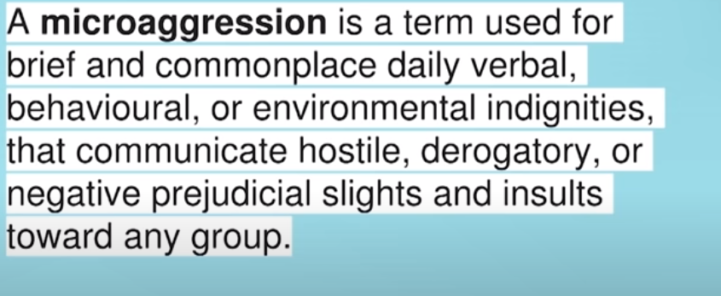
Key definitions
Microaggression
A microaggression is a term used for brief and daily commonplace verbal, behavioral or environmental indignities that communicate hostile, derogatory, or negative prejudicial slights and insults toward any group or individual.
Originally coined by:
Chester M. Pierce in 1970s
Often targeted at marginalised groups.
Cloaked as banter, jokes, jibes but undermining.
Notes:
Find short video to support this section.

Slide 24
Microaggressions Activity
We have probably all experienced microaggressions
Hostility, attempts to deride, exclude us on grounds of age, race, class, gender etc.
Invite you to share any experiences in chat.

Slide 25



BREAK
Notes:
15 minutes

Slide 26
Psychological harm of discrimination
‘Weathering’-wear and tear on the mind and body, cognitive load of being marginalized or discriminated against or excluded- physiological impact= biological ageing, stress.
https://www.peoplemanagement.co.uk/voices/comment/what-hr-managers-need-to-know-about-misogynoir

Slide 27
Psychological harm of discrimination
Commonly applied to intersectionality, cases of race discrimination/ aggression
Weathering could apply to anyone in marginalised groups, e.g. older women
Psychological injury to feelings often a component of discrimination cases at tribunal £400,000 awarded in damages injury to feelings alone £42,809
https://www.personneltoday.com/hr/giwa-amu-v-department-for-work-and-pensions-injury-to-feelings/
The employment tribunal upheld 12 of the 19 complaints of direct discrimination, victimisation or harassment relevant to race and or age. It found that the DWP staff had deliberately created a “hostile environment” for Ms Giwa-Amu. The case identified race and age as reasons why this individual was discriminated against.

Slide 28
Working with unconscious processes
We are more likely to be able to spot bias in others rather than in ourselves.
Challenge cultural stereotypes.
Call out issues…but
Power is always in the room - social, economic and political circumstances often dampen down behaviours in response to being controlled.
Notes:
Re control give example if you want to stick up for person being bullied you have to do an analysis if it could be harmful to you too. Know right thing to do, but hard to do it.

Slide 29
ALLYSHIP
‘The quality of practice of helping or supporting other people who are part of a group that is treated badly or unfairly, although you are not yourself a member of this group.’
Source: Cambridge Dictionary
https://dictionary.cambridge.org/dictionary/english/allyship
Notes:
https://www.allyship.co.uk/
https://hbr.org/2020/11/be-a-better-ally
https://www.edi.nih.gov/blog/communities/what-allyship
https://www.hrmagazine.co.uk/content/features/six-tips-for-being-a-good-workplace-ally

Slide 30
ALLYSHIP
Educate yourself about privilege and exclusion.
Stand up for others
Small actions can have big impacts!
Examples:
Supporting someone’s idea in a meeting.
Men can provide allyship to women by standing up for gender equality.
Notes:
https://www.allyship.co.uk/
https://hbr.org/2020/11/be-a-better-ally
https://www.edi.nih.gov/blog/communities/what-allyship
https://www.hrmagazine.co.uk/content/features/six-tips-for-being-a-good-workplace-ally

Slide 31
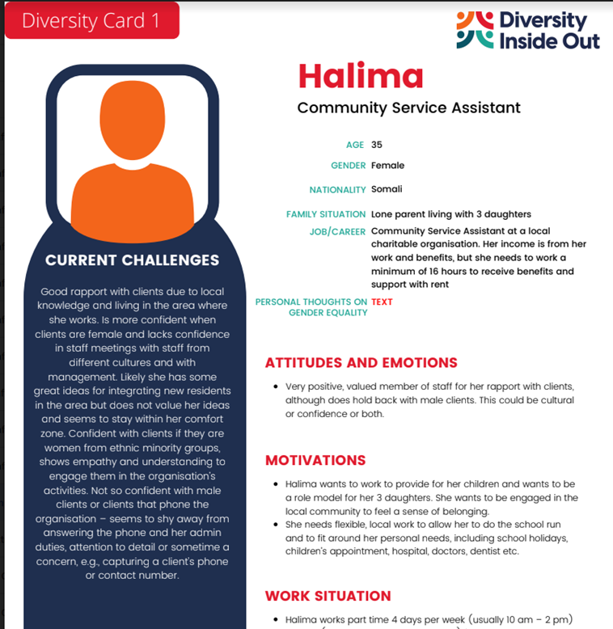
What do we mean by flexibility ?
Case studies/
Diversity Cards
Flexibility caring responsibilities, children
Disability reasonable adjustments
Neurodiversity
Notes:
Use case studies or the diversity cards for learners to discuss in their groups to see where flexibility could be applied to specific jobs or individuals.

Slide 32
Benefits of in-organisation lived experience research
Can offer renewed energy to drive change
Collects new data for a richer picture to understand issues
Could reveal hidden issues senior management not even aware of
Enables more nuanced responses
Full context needs to be communicated-provide psychological safety
Avoid ‘project’ mentality
Data collection: Needs to be analysed, followed by action (timely)
Start to take action and implement plans for change quite quickly

Slide 33
Case Study Discussion-Diversity Cards
Ling
Andreas
Debrief any insights/learning.

Slide 34
Flexibility advantage for employees
Avoiding fake flex
Challenge to recruit and keep employees

Slide 35
What is fake flex?
“Fake-flex”, a term coined by Flex Appeal campaigners Anna Whitehouse and Matt Farquharson, is used to define home working without proper policies in places that require employees to be constantly online or available for their business.
https://techmonitor.ai/leadership/workforce/fake-flex-working-homeworking-covid-19#:~:text=%E2%80%9CFake%2Dflex%E2%80%9D%2C%20a,or%20available%20for%20their%20business.

Slide 36
Avoiding fake flex?
Develop policies that reflect working from home and hybrid working.
Establish team practices that keep staff connected, regular team meetings, online chat, quiet work time, Q and A sessions.
Establish what flexibility in contracts will enable you to recruit the best staff.
Optimize segmented marketing for different generations of staff-recruitment.
Offer flexible benefits packages-may depend on size of organisation and resources.

Slide 37
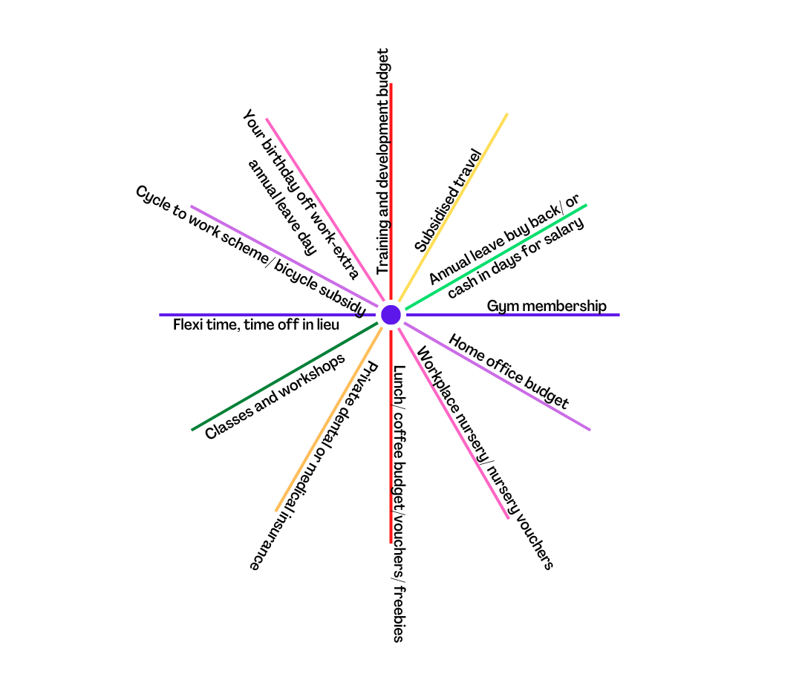
Flexible benefits-any more to add?
Low cost and high cost options.
Notes:
Wheel of flexible benefits graphic designed by Inova
Your birthday off work-extra annual leave day
Training and development budget
Subsidised travel
Annual leave buy back/ or cash in days for salary
Gym membership
Home office budget
Workplace nursery/ nursery vouchers
Lunch/ coffee budget/vouchers/ freebies
Private dental or medical insurance
Classes and workshops
Flexi time, time off in lieu
Cycle to work scheme/ bicycle subsidy
Technology companies often lead on benefits packages-see Otta.com

Slide 38
Post Covid-19- research-jobs re-set
World Economic Forum
Post-pandemic, most employees want to work from home three days a week, a new McKinsey & Company report shows.
More than 25% said that they would consider switching employers if their organization returns to fully on-site work.
Mental health is a top priority.
The world is facing a ‘double-disruption’ scenario, with automation and COVID-19, according to the World Economic Forum.
Source:
https://www.weforum.org/agenda/2021/05/employers-pandemic-covid-19-mental-health/
Photo by Anna Dziubinska on Unsplash
Notes:
https://www.weforum.org/agenda/2021/05/employers-pandemic-covid-19-mental-health/
https://www.cipd.co.uk/Images/flexible-hybrid-working-practices-report_tcm18-108941.pdf

Slide 39
Mentimeter
What action can you take to implement changes?
Describe any opportunities you see to be an ally.
What flexible benefit would you value most?

Slide 40

Evaluation form
Please complete this short evaluation form found in chat
Your feedback is so valuable to us!
Notes:
Add link in chat – allow 5 minutes

Slide 41
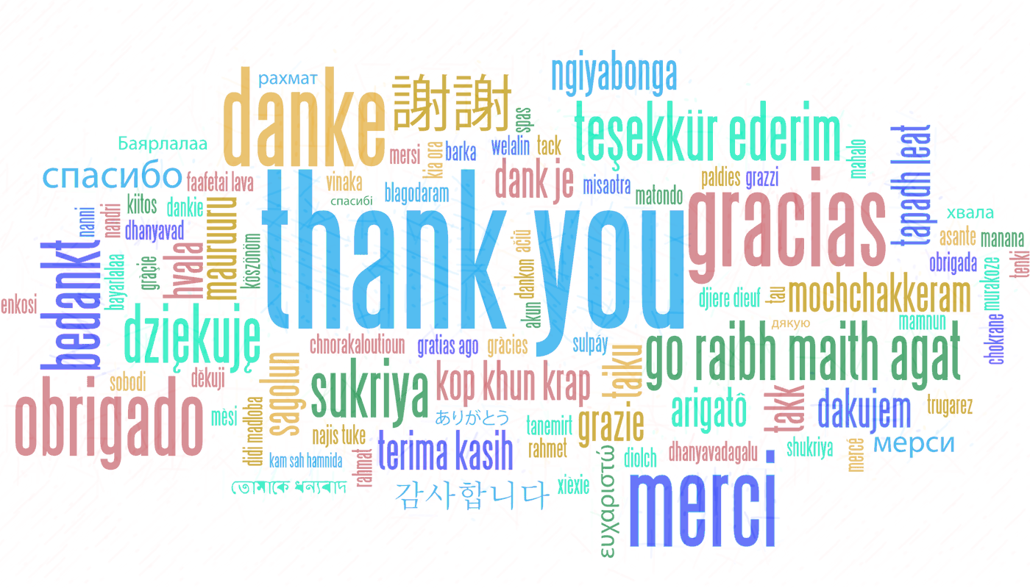
Any Questions?
It’s been great to work with you all!
Thank you!

Slide 42


References and sources
https://www.mckinsey.com/business-functions/organization/our-insights/gender-diversity-a-corporate-performance-driver
https://assets.publishing.service.gov.uk/government/uploads/system/uploads/attachment_data/file/594336/race-in-workplace-mcgregor-smith-review.pdf
https://www.gov.uk/government/publications/the-report-of-the-commission-on-race-and-ethnic-disparities/summary-of-recommendations
https://www.gov.uk/government/publications/unconscious-bias-and-diversity-training-what-the-evidence-says
https://hbr.org/2021/02/are-your-diversity-efforts-othering-underrepresented-groups
https://www.medicalnewstoday.com/articles/weathering-what-are-the-health-effects-of-stress-and-discrimination#Quantifying-the-effects-of-weathering
https://libguides.kent-school.edu/race-racism-antiracism/ally
https://hbr.org/2021/04/research-adding-women-to-the-c-suite-changes-how-companies-think?utm_campaign=hbr&utm_medium=social&utm_source=linkedin
https://wgha.org.au/how-to-avoid-gender-bias-in-performance-reviews/
https://www.gartner.com/smarterwithgartner/9-future-of-work-trends-post-covid-19
https://www.cipd.co.uk/news-views/campaigns/flex-from-first#gref

Slide 43
Additional information and useful websites
https://www.peoplemanagement.co.uk/news/articles/three-quarters-men-feel-stigmatised-taking-extended-paternity-leave
Document with timelines of legislation and women’s rights and gender equality pertaining to reproductive rights and sexual health, violence against women, home and family, education, work, women in senior roles, political representation:
https://www.fawcettsociety.org.uk/Handlers/Download.ashx?IDMF=45a5a7f5-ffbd-4078-b0b7-4bfcccab159d
https://www.vox.com/2015/2/16/8031073/what-are-microaggressions
http://genderedinnovations.stanford.edu/policy/timeline.html
https://socialprotection-humanrights.org/key-issues/disadvantaged-and-vulnerable-groups/lgbtqi/
Notes:
https://www.thecareerpsychologist.com/wp-content/uploads/Daily-working-from-home-TCP-checklist-v2.pdf
See website above also for Covey’s circle of influence.

Slide 44
Thank you!
"The European Commission support for the production of this publication does not constitute an endorsement of the contents which reflects the views only of the authors, and the Commission cannot be held responsible for any use which may be made of the information contained therein."

